Slide 1
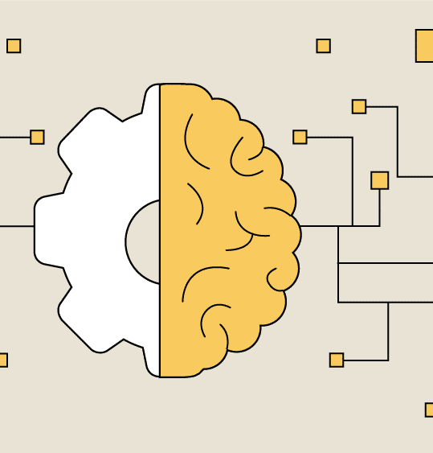
Ovarian Cancer Detection Using Machine Learning
By~ Aditi, Deep, Nischay Rawat

Slide 2
Introduction
Prevalence and Statistics:
Ovarian cancer is the fifth leading cause of cancer-related deaths among women.
It is often diagnosed at an advanced stage due to non-specific symptoms, contributing to a lower survival rate.
Importance of Early Detection:
Early-stage detection (Stage I or II) significantly increases the 5-year survival rate (approximately 90%).
Late-stage detection (Stage III or IV) has a much lower survival rate (around 30%).
Current Screening Challenges:
Lack of reliable early screening tests.
Symptoms can be vague and similar to less serious conditions.

Slide 3
Problem Statement
Challenges in Early Diagnosis:
Most women show no clear signs until the disease progresses, making early diagnosis difficult.
Existing diagnostic methods like ultrasound and CA-125 blood tests are limited in specificity and sensitivity.
Need for Innovation:
There's a significant gap in non-invasive, reliable, and accurate early detection techniques.
Machine learning offers a potential solution by analyzing large data sets for patterns not easily visible to human experts.

Slide 4

Objective
Goal of the Project:
Develop a machine learning model capable of accurately predicting the presence of ovarian cancer based on multiple clinical markers and blood tests.
Impact:
Enhance early detection capabilities, leading to better treatment outcomes and increased survival rates.
Scope:
Integrate various data sources (markers, blood routine, general chemical tests) into a comprehensive model.
Test and compare the effectiveness of different algorithms (e.g., KNN, Random Forest, Decision Tree).

Slide 5
Data Overview
Datasets Used:
OC_Marker.csv: Contains patient age and cancer markers.
OC_General_Chem.csv: Contains general chemical parameters.
OC_Blood_Routine.csv: Contains routine blood test data.
Feature Engineering:
Merging datasets on the Age column.
Dropping unnecessary columns.
Scaling the features using MinMaxScaler.

Slide 6
Machine Learning Models Used
Models:
K-Nearest Neighbors (KNN)
Random Forest Classifier (RFC)
Decision Tree Classifier (DT)
Goal:
Compare the performance of each model in detecting ovarian cancer

Slide 7
Overfitting and Underfitting in RFC and DT
Definition of Overfitting:
High training accuracy but poor test accuracy (model is too complex).
Example: Deep decision trees or too many random forests with high depth can overfit.
Definition of Underfitting:
Both training and test accuracy are low (model is too simple).
Example: Shallow trees or small k in KNN might underfit.

Slide 8
Principal component analysis
What is PCA?
Benefits of Using PCA for Feature Selection:
Principal Component Analysis (PCA) is a dimensionality reduction technique that transforms a dataset into a set of linearly uncorrelated components called principal components, ranked by the variance they capture.
PCA reduces the dataset’s dimensions to 2 principal components while retaining most of its variance. This helps focus on the most significant features or combinations of features, using the transformed dataset (X_pca) instead of the original features.
Removes Redundancy: Combines correlated features into principal components, eliminating redundancy.
Focuses on Informative Features: Retains components with the most variance.
Improves Model Performance: Reduces feature space for better computational efficiency and less risk of overfitting.

Slide 9
Model Performance
Metrics:
Accuracy, Precision, Recall, F1-Score, ROC-AUC for each model.
Visuals:
Confusion Matrices for each model (RFC, DT, KNN).
Classification Reports: For each model, displaying precision, recall, and F1-score.

Slide 10
Cross-Validation and Hyperparameter Tuning
Random Forest and Decision Tree: Use GridSearchCV for hyperparameter tuning
KNN: Cross-validation to select the optimal k
Visual: Results of hyperparameter tuning (Best Parameters, GridSearchCV results).

Slide 11
Conclusion
Summary:
Models like Random Forest and Decision Tree can detect ovarian cancer with good accuracy.
Overfitting and underfitting were managed using parameter tuning.
KNN performed well once the optimal k was chosen.
Impact: This machine learning-based approach can be used to aid doctors in early detection.

Slide 12
Future Work
Improvements:
Include more data (e.g., genetic factors, additional clinical tests).
Try advanced models like Support Vector Machines (SVM) or Neural Networks for better accuracy.
Deployment: Integrate the model into a diagnostic tool for healthcare providers.

Slide 13
THANK YOU

